Slide 1
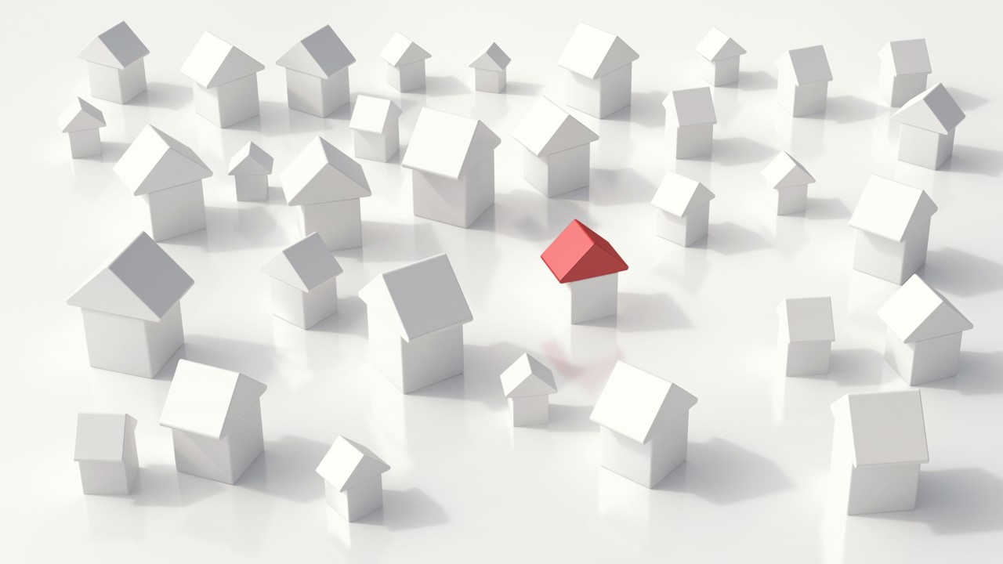
House Price Prediction

Slide 2
Problem statement
The project aims to analyze various factors of houses corresponding to their price via generating and comparing the accuracy of used models to predict the house prices using the following three ML algorithms:
Multiple linear regression
Decision tree
Random forest regression
Housing price is strongly correlated to other factors such as location, area, population, as it requires information apart from HPI to predict individual housing prices.

Slide 3
Objectives
Understand
Understand and study the correlation between variables and house price
Visualize
Visualize the given data to provide an insight for future decisions
Recognize
Recognize the most suitable models or algorithms required for prediction
Compare
Compare the accuracy of models
Develop
Develop an efficient and accurate system for house price prediction
Train
Use machine learning algorithms to train the model

Slide 4
Data Scraping
Data or web scraping is the process of importing information from websites into a data file
Used Python libraries like Selenium, BeautifulSoup and Pandas
Scraped New York city data with major attributes from a real estate website
Link: https://www.realtor.com/

Slide 5
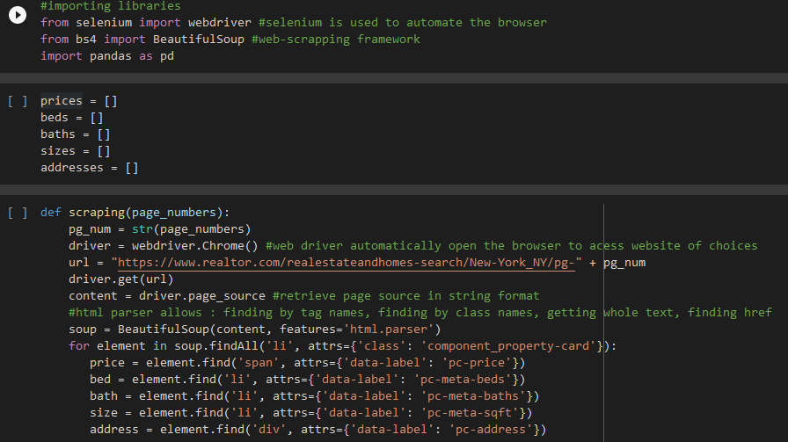
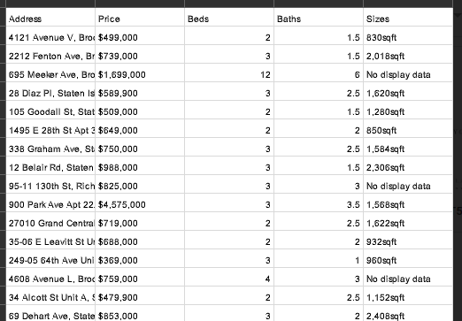
DATA SCRAPING

Slide 6
DATASET USED
King County’s dataset is used from Kaggle published under CC0
Contains house sale prices for King County, which includes sales between May 2014 and May 2015
The dataset consisted of 21 variables and 21613 observations
Link: https://www.kaggle.com/datasets/shivachandel/kc-house-data

Slide 7
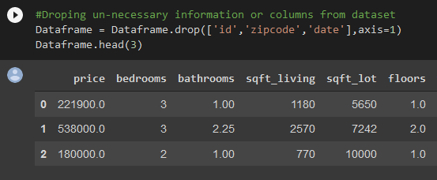
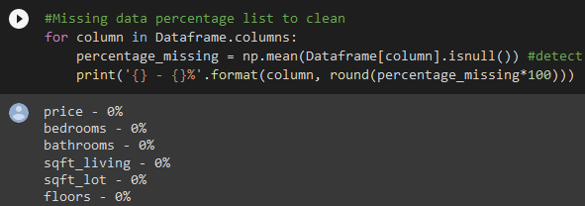
Data Pre-processing and Cleaning
Data preprocessing or can refer to manipulation or dropping of data before it is used in order to ensure or enhance performance
Data cleaning is the process of detecting and correcting corrupt or inaccurate records from a record set, table, or database
Performed pre-processing steps on dataset like removing of zip code, day, month and year to enhance performance
Performed checks whether data cleaning is required or not, no irregularities were found

Slide 8
Data Visualization
Data visualization is the graphical representation of information and data.
Particularly efficient way of communicating when the data is numerous as of our dataset.
We used the following visualization techniques to get information about dataset:
Histogram
Count plot
Scatter plot
Heatmap

Slide 9
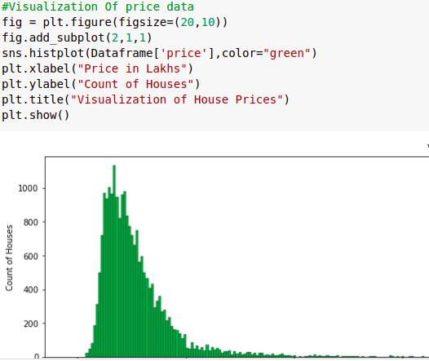
Histogram

Slide 10
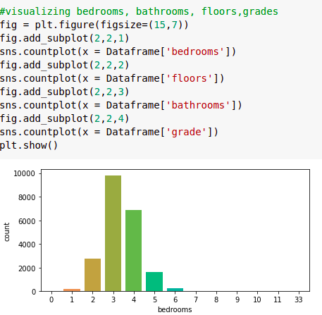
Count Plot

Slide 11
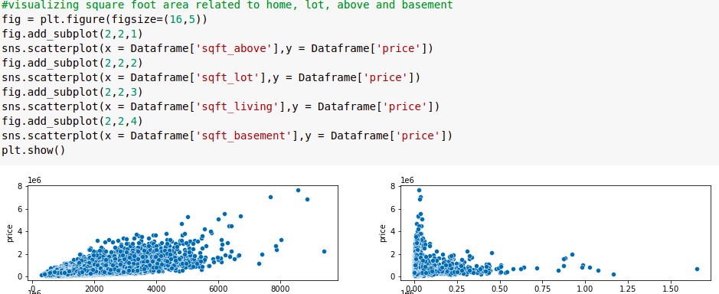
Scatter Plot

Slide 12
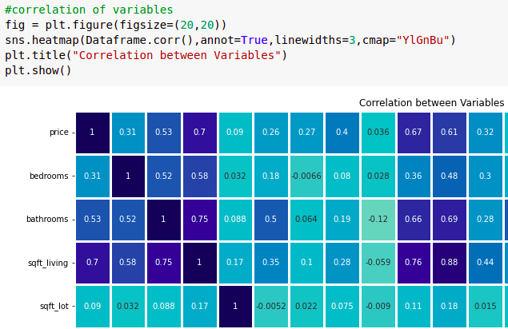
Heatmap

Slide 13
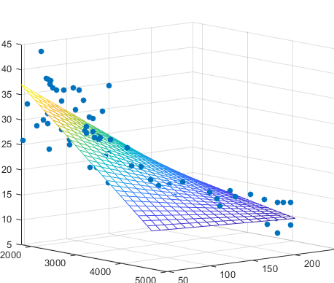
Model #1: Multiple Linear Regression
Regression models are used to describe relationships between variables by curve fitting to the observed data
Multiple linear regression is used to estimate the relationship between two or more independent variables and one dependent variable
We used this model to estimate the price of house (dependent variable) at a certain value of the independent variables

Slide 14
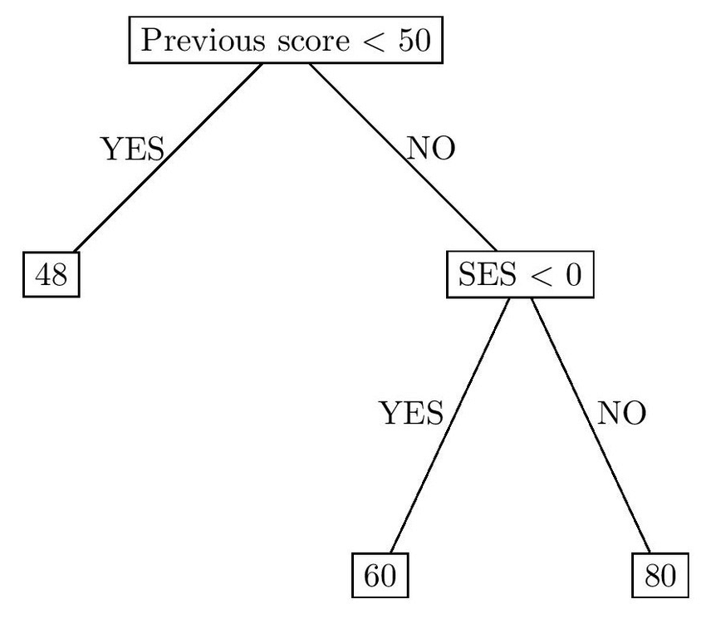
Model #2: Decision Tree
A decision tree is a tree-like graph where internal nodes represent the features of a dataset, branches represent the decision rules, and each leaf node represents the outcome
The basic goal of a decision tree is to split a population of data into smaller segments
We used regression tree (a type of decision tree) to predict continuous quantitative data

Slide 15
Model #3: Random Forest Regression
Random forest algorithm is widely used for classification and regression problems
It builds decision trees on different samples and takes their majority vote for classification and average in case of regression, to predict the values
The greater number of trees in the forest leads to higher accuracy

Slide 16
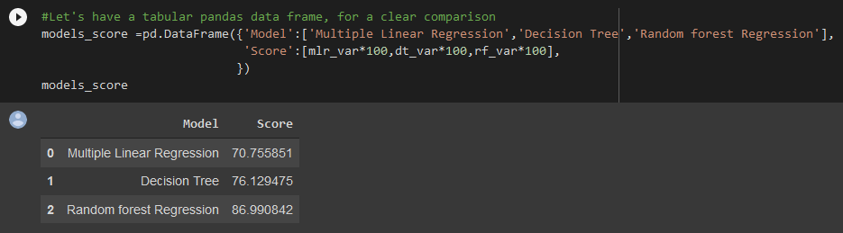
Testing and Conclusion
Accuracy obtained after applying above models over test dataset:
From the results obtained after testing it can be concluded that the price of houses depends on different features related with houses and it can be predicted most accurately by using Random Forest Regression Model

Slide 17
THANK YOU!

